Slide 1

Predicting
IRIS SPECIES USING MACHINE LEARNING
presented by AdITYA FADLANI
digital skill fair 36.0

Slide 2
table of
CONTENT
Presentation are communication tools that can be used as demontrations, lectures, reports, and more. it is mostly presented before an audience.
about me
tools & library
about project
Data Set Characteristics
Model Performance & Evaluation
Conclusion
Page 02 of 11

Slide 3

Aditya Fadlani
Analytical Thinker | Adaptive Learner | Data Enthusiast
A versatile graduate with a strong analytical mindset and a passion for extracting insights from data. Holds a degree in Agroecotechnology from Universitas Brawijaya and is currently expanding expertise in data science and machine learning. Highly adaptable and eager to apply data-driven solutions across various industries.
digital skill fair 36.0
Page 03 of 11

Slide 4






Page 04 of 11
Tools &
LIBRARY

Slide 5
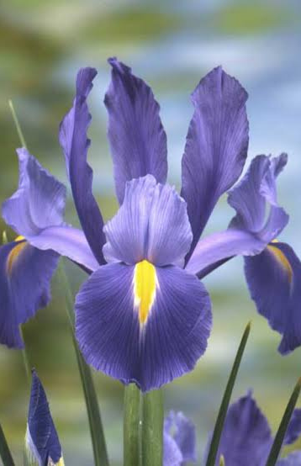
Page 05 of 11
ABOUT PROJECT
This project focuses on building a machine learning classification model using the Iris dataset from Scikit-Learn. The Iris dataset is a well-known dataset in pattern recognition, containing measurements of sepal and petal dimensions for three species of iris flowers: Setosa, Versicolor, and Virginica.
For this classification task, I implemented the Random Forest algorithm to predict the species of an iris flower based on its given features. The dataset was split into training and testing sets, and model performance was evaluated using accuracy, a confusion matrix, and a classification report.

Slide 6
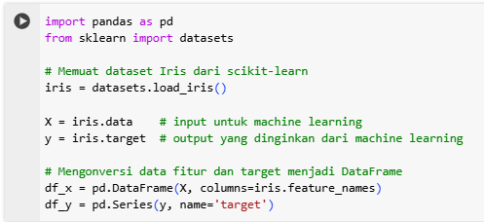
Page 06 of 11
DATA SET CHARACTERISTICS
Number of Instances: 150 (50 in each of three classes)
Number of Attributes: 4 numeric, predictive attributes and the class
Attribute Information:
sepal length in cm
sepal width in cm
petal length in cm
petal width in cm
class:
Iris-Setosa
Iris-Versicolour
Iris-Virginica

Slide 7

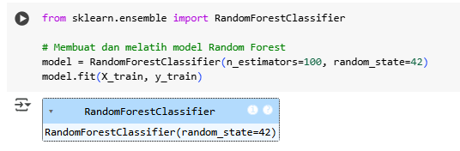
Page 07 of 11
Split Data
Model Performance &
Train the Model
EVALUATION

Slide 8
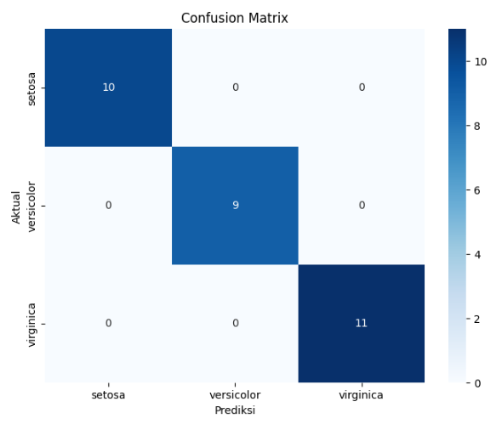
Page 08 of 11

Slide 9
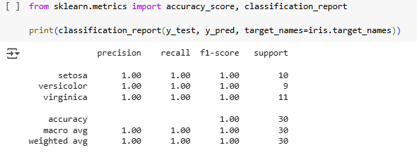
Page 09 of 11
Model Performance Interpretation
The classification report shows that the Random Forest model achieved a perfect accuracy of 100% on the test dataset. All three classes (Setosa, Versicolor, and Virginica) have a precision, recall, and F1-score of 1.00, meaning the model made no misclassifications. This indicates that the model is highly effective for classifying the Iris dataset. However, further validation on unseen data is recommended to ensure robustness.

Slide 10
1. High Model Accuracy
The Random Forest model achieved 100% accuracy, meaning it correctly classified all Iris flower species without any mistakes.
2. Purpose of the Analysis
The goal of this analysis is to classify different types of Iris flowers based on their characteristics, such as petal and sepal size. This helps in understanding plant species better and can be useful in research or agriculture.
3. Potential Overfitting Risk
Even though the model performs perfectly on this dataset, it might not work as well on new, unseen data. Further testing is needed to make sure the model is truly reliable.
Page 10 of 11
CONCLUSION

Slide 11


Page 11 of 11
let's work
together
github.com/fadlani-aditya
+628-1258-440097
adityafadlani48@gmail.com
linkedin.com/in/aditya-fadlani

